Slide 1
DR SNSRCAS, CBE Human Centered Design Thinking Fundamentals 21PCA204 I MCA ODD SEM UNIT II User Research Report

Slide 2
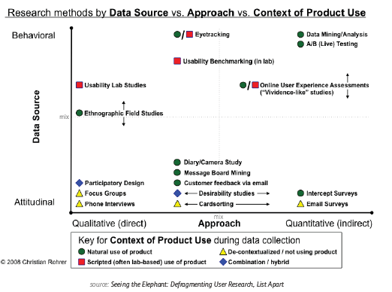
User Research Report
Once you’ve checked your product or prototype against best practices, it’s time
to verify those findings with real users. Tactics like card sorting, tree testing,
moderated user testing, unmoderated user testing, and other techniques can all be
used (as you’ll see in the illustration below). We won’t discuss all the tactics, but we
will provide a general framework.

Slide 3
User Research Report
While usability testing is more expensive than heuristic evaluations since you need
to plan and recruit for controlled experiments, there is no better way to see how
your product might perform in the wild. According to David Sherwin, Design
Director at Frog, market research explains what users do and when they do it, but
user research completes the picture by answering why they do it and how your
product design can react accordingly.
Objectives — Create framing questions like ”Who would share video clips?”,
and ”Why would they share these clips?”. Prioritize the most important
questions, and then translate them into focused objectives like ”Determine
how frequent TV viewers in China decide what shows to record to watch later”.
• Hypotheses — Using your framing questions spend up to 8 minutes
individually sketching answers. You may generate attitudinal hypotheses
(TV watchers on social networks like to know their friends’ favorite shows),
behavioral hypotheses (TV watchers only share clips from shows they watch
frequently), or feature-related hypotheses (TV watchers will share clips if
they’re popular with others).

Slide 4
User Research Report
Methods — Sort all your hypotheses based on themes (attitude/behavior/
feature) and then assign testing tactics. For example, observational and
contextual interviews are great for building a foundation of knowledge. Diary
studies, card sorting, paper prototyping, and other collaborative activities help
explore design ideas.
• Conduct — Recruit around 8 users for 3 testing sessions each (1 hour length).
Develop an interview guide and then document all the notes, photos, and
videos as you test. Constantly ask yourself if you’re discovering what you need
to learn in order to achieve your objectives. If not, switch tactics.
• Synthesize — The why behind the data is more important than the what.
Is there a pattern that suggests you need new designs? Did what you learn
change how you should frame your research objective? And do you need to
change the design activities that you’ve planned?

Slide 5
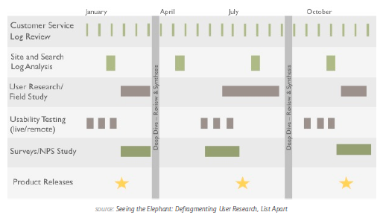
User Research Report
As you can see in the below diagram, there’s many different methods you can build
into your overall testing plan.

Slide 6
User Research Report
Demetrius Madrigal and Bryan McClain, founders of Metric Lab, provide
a helpful list of Do’s and Don’ts for usability testing. For example, you should
get involved and observe as much testing as possible, but don’t jump to design
conclusions based on only a handful of tests. And while you shouldn’t hide yourself
from participants using a one-way mirror, you also shouldn’t turn your testing
session into a product demo.
By sticking to a regimented user testing plan, Volusion was actually able to increase
paid conversions by 10% and product trials by 6%. While they used a very specific
formula of video-recorded testing sessions and A/B testing, it’s certainly proof that
the process works.
If you’re looking for a leaner user research approach, you can follow this user
testing framework (which you can learn in 10 minutes) and then document your
plan in a simple format that resonates with stakeholders.
At UXPin, we’re big fans of guerilla testing (as discussed on p.39 of the UX Design for
Startups e-book). When testing new features, we enlist the help of User Testing to record
on video the reactions of designers, UX professionals, and product managers. On the
research side, we conduct in-depth interviews with product managers and UX folks
from companies like Uber, Google, Etsy, and Apple to understand their pain points, their
needs, and how UXPin fits in.

Slide 7
THANK YOU

